Slide 1

Notes:
This presentation with cover several topics: company structure, roles & responsibilities, the current project roadmap, a future project roadmap, and structured thinking around consumer data.

Slide 2
Social Data Valuation
Measuring Sports Moments & NFTs

Slide 3
Athlete Data: Cross-channel Social Moment Valuation
DL can combine social media data across multiple platforms, identify the most important moments, and estimate their value. From this we can predict the type of content that will be most likely to generate fan engagement in the future, and estimate the mix of media (social vs video) that creates the optimum amount of engagement.
We can also answer questions like:
How does social media engagement convert into ad revenue?
How much is online engagement worth?
How much are major sports moments worth outside of television, to the athlete, team, and league?
How much money does a 35-point LeBron game generate? How much have previous games generated?
Notes:
When event happens:
Takes photo or hashtag: what we can predict is how many more likes/followers or engagements will happen around an event happening in near real-time
Example: categorize photos, such as “win” or “fan moment”, based on past historical data, how much followers, likes, retweets, comments, each category was getting; we can use that historical data to say “between these two categories, which one will be more likely to generate this type of engagement” – helps predict the type of content you should produce in the future that would be more successful – help maximize engagement! – also predict how much interaction you can expect in the future – sentiment analysis – how does this convert into ad revenue? How does engagement translate into money being made? – NFT is the monetization strategy – NFTs can be sold to sponsors -

Slide 4
Fan Data: Cross-channel Social Moment Valuation
Analyze fan data and to find valuable moments:
Posts with highest engagements
Creators of iconic hashtag
Viral videos or photos
Answer questions like:
How much ad revenue do big sports moments create outside of television?
How much value does each player contribute to an important sports “moment”?
How much value does a player’s “brand” contribute to the overall value of the sports’ brand?
How much value do fans bring to online engagements?
This information can be aggregated to help measure the value of important sports moments (scores, big plays, etc.).
Notes:
When event happens:
Takes photo or hashtag: what we can predict is how many more likes/followers or engagements will happen around an event happening in near real-time
Example: categorize photos, such as “win” or “fan moment”, based on past historical data, how much followers, likes, retweets, comments, each category was getting; we can use that historical data to say “between these two categories, which one will be more likely to generate this type of engagement” – helps predict the type of content you should produce in the future that would be more successful – help maximize engagement! – also predict how much interaction you can expect in the future – sentiment analysis – how does this convert into ad revenue? How does engagement translate into money being made? – NFT is the monetization strategy – NFTs can be sold to sponsors -

Slide 5
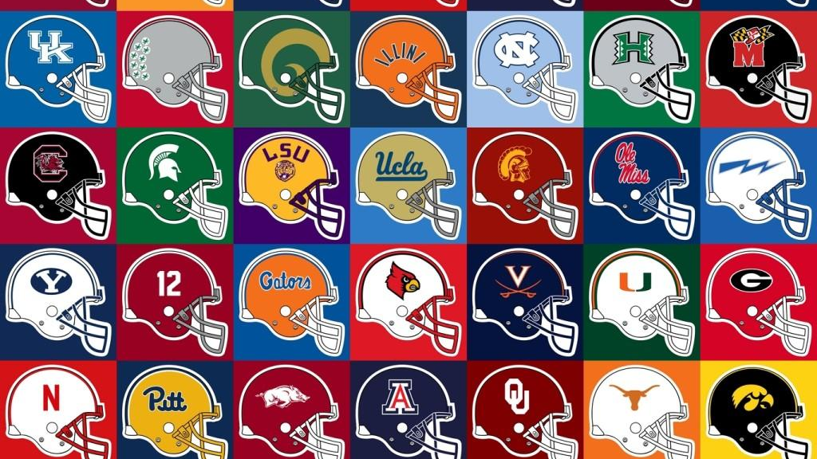
College Athlete Data
Determine the value of Name, Image, and Likeness (NIL) for college athletes:
Universities can provide DL analysis as a tool for young athletes to understand their own net-worth and help monetize themselves early.
Provide leverage to Universities:
Schools can aggregate these valuations and prove their team’s net value as a bargaining chip in negotiations with brands, leagues, and beyond.

Slide 6
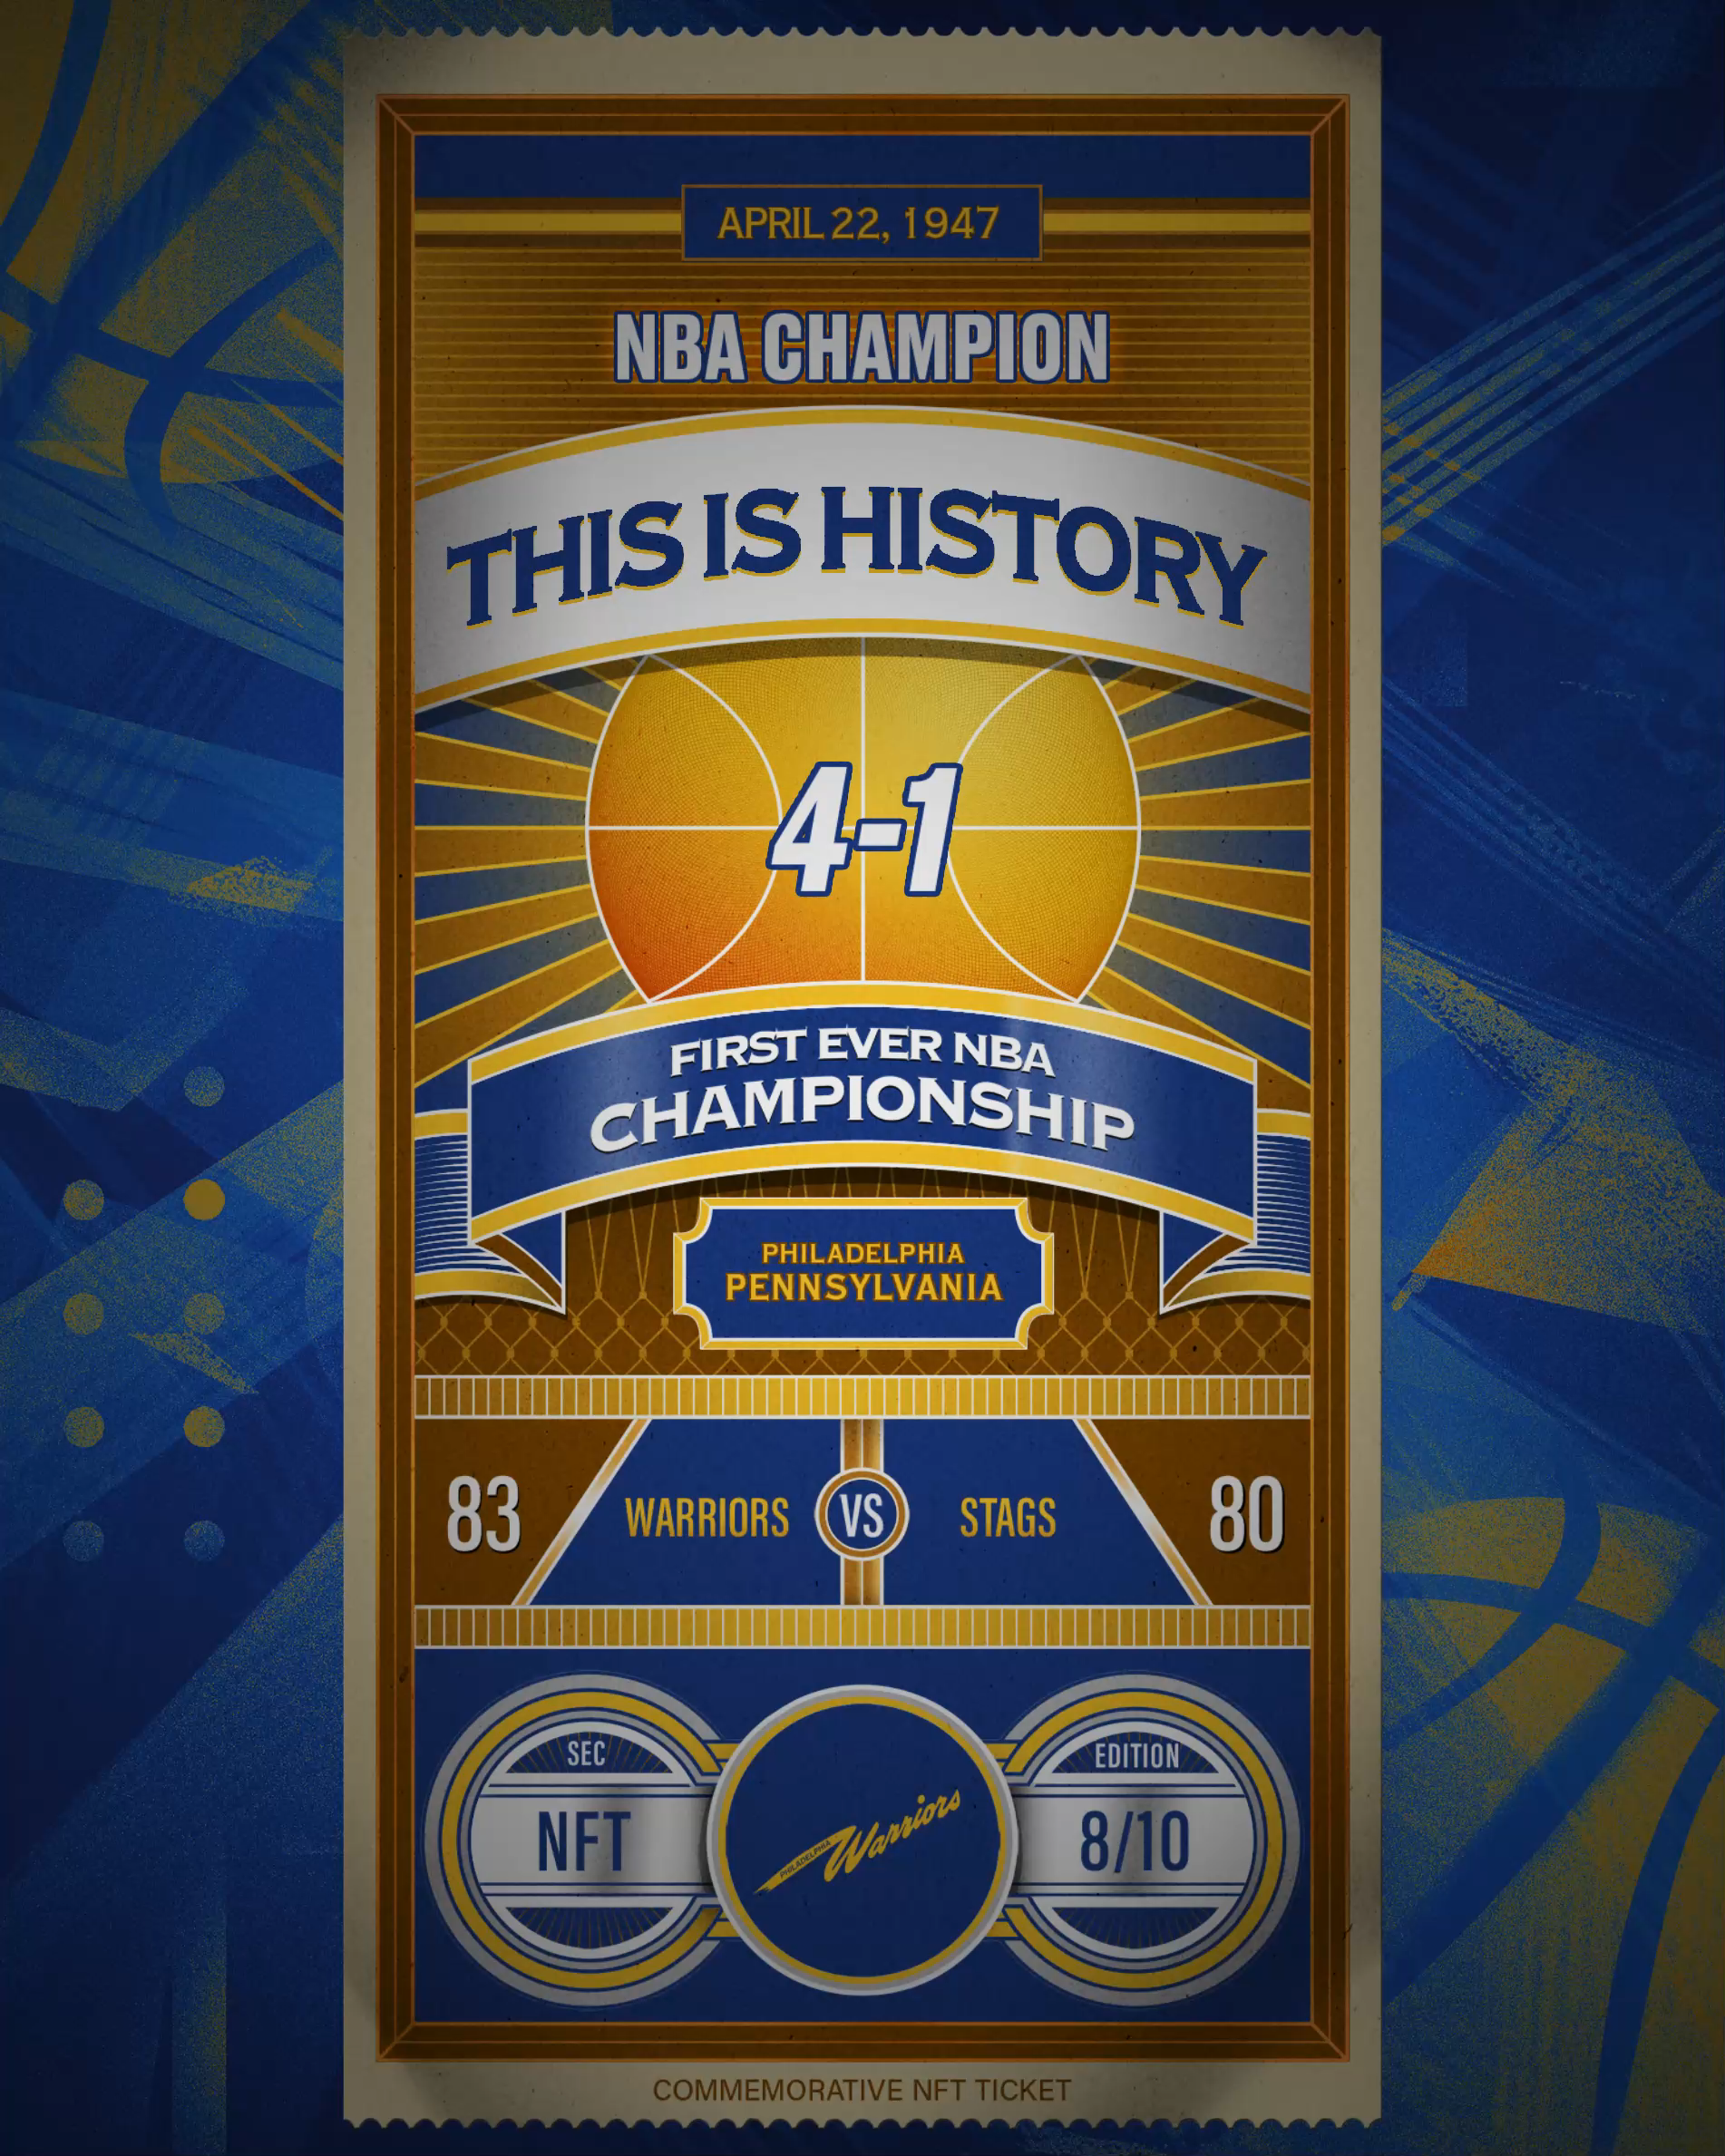
NFTs from Social Moments
Players, leagues, and teams, can create serialized NFTs from the moments mined from social media data gathered by DL.
These moments can be officially licensed by NBA, or player’s themselves (as long as they own the IP to the underlying asset), that can be resold by the fans.
Initial price floors are set by the NFT minter, but subsequent valuations are determined by the free market.
The license holders receive a percentage of the sale each time the NFT changes hands.
Other NFT ideas:
Combine different digital assets into an NFT “package” and sell to fans as collectible item.
Provide NFT futures based on game performance.
Right: Currently the Golden State Warriors produce commemorative NFT “tickets” that can be bought on OpenSea.

Slide 7

NFT Revenue Sharing
Determine the contributions of creating and spreading digital assets that later become profitable NFTs from other content creators, such as:
Celebrity social media accounts.
Company and Brand social media accounts.
Individual fans’ social media account.
NFTs ensure the original content creator gets certain percentage of the revenue cut:
DL analyzes social media engagements from all parties, including overall NFT profit and/or ad revenue data.
The NFT profit and resulting ad are distributed among the involved parties based on the contribution calculated from the analysis.

Slide 8
Data Campaign: NFT Fan Competition
Contest: Who took the most valuable picture from the stands?
Solicit fan participation in the DL exchange and reward with collectible NFTs produced from:
Athlete data
Famous moments found in fan data
Third party data
Build in kickbacks for players, teams, leagues, etc. into the NFT contract to generate revenue for all parties.

Slide 9
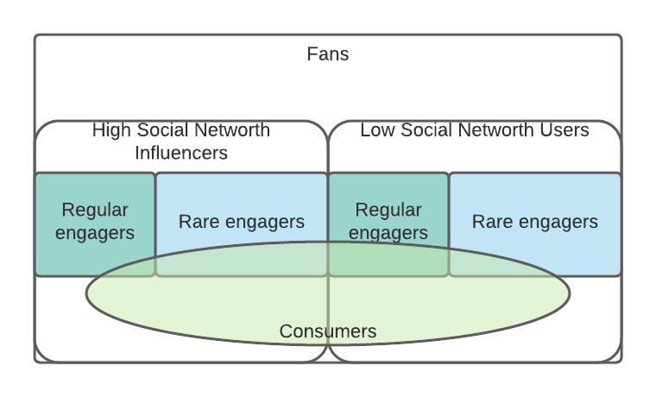
NFT Fan Competition (continued)
Based on the fans’ social media historical data, DL AI can determine:
Which fans to leverage to make the NFTs/Ads generate more buzz
Which fans to sell to in order to generate more NFTs/Ad revenue

Slide 10
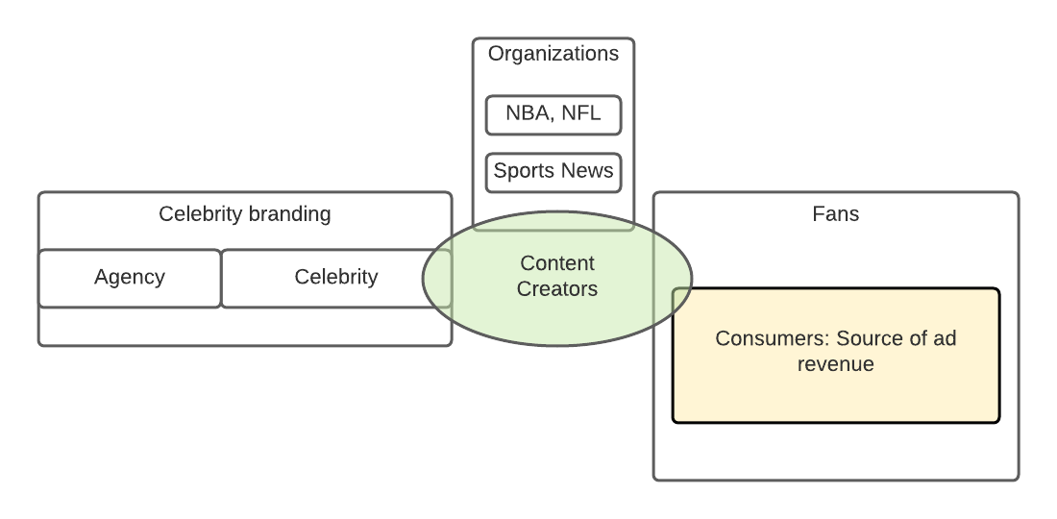
Non-sports Entertainment Figures
All parties involved in creating/spreading valuable digital assets/NFTs; these parties could overlap. The relationship between these parties are explained in the graph
Agency
Celebrity
Fans
Consumers
Social media content creators

Slide 11
NFTs Link Sports & Video Games
Gaming is extremely popular among sports fans, and many athletes stream themselves playing games on video platforms like Twitch and YouTube.
NFTs provide athletes an opportunity to sponsor items and events in video games to earn additional revenue.
Examples of licensed digital items being sold in video games now include the NFL/Fortnite crossover, the NBA 2K esports League, and the eNASCAR esports racing series.

Slide 12
Notes:
This presentation with cover several topics: company structure, roles & responsibilities, the current project roadmap, a future project roadmap, and structured thinking around consumer data.

Slide 13
Ideas
“First Post” – give historical credit to the first fan that interacted with your most famous moments
“Rookie Card” – NFT social data mining service for fans celebrities

